Slide 1
FieldArcheryFinder (FAF)
Enterprise Web Development 2017
Assignment 1: Create a SPA using ReactJS
https://github.com/ellingworthl/EDW_Assign1_SPA
Assignment 2: Integrate Web API with SPA using Node, Express, MongoDB, & Mongoose
https://github.com/ellingworthl/EWD_Assign2_WebAPI

Slide 2
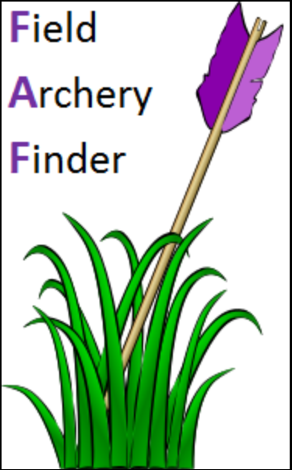
Field Archery Finder (FAF) - Concept
My hobby is field archery. As a newbie I found it difficult to locate shoot venues, particularly those sent in forestry. I couldn't 'just' look-up details about the venue as information wasn’t always persistent online.
Sorted! FAF has a ‘Venues’ page.
There’s a cooperative approach to archery in Ireland, so knowing what’s on, where and who’s hosting it is vital.
Sorted! FAF has an ‘Events’ page.
As a small community we often lament that it would be nice to be able to post 'shoot reviews' and share them with the host club, archers in the same target group and the wider community... if only we had such a facility?
Sorted! FAF has a ‘Reviews’ page.
FAF’s objective is to holistically help existing and new archers find field archery venues (clubs) in their area, look-up, and manage, events being held and be able to submit reviews about a club/an event they attend. Basically, share experiences and grow field archery in Ireland.
Having these facilities on one site makes life terribly handy and will have a broad appeal to anyone interested in the sport.

Slide 3
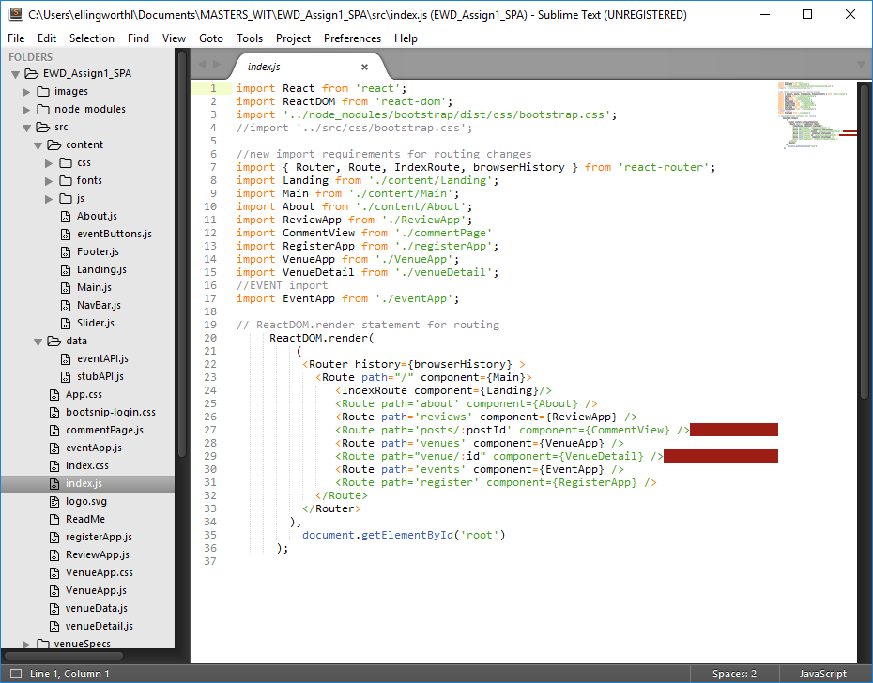
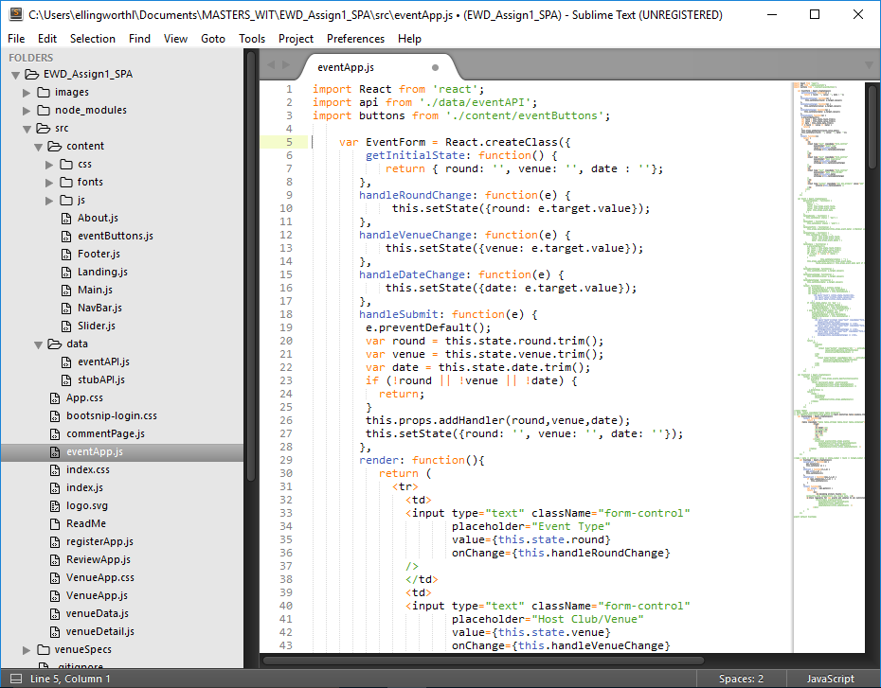
Assignment 1 - Create a SPA with ReactJS
FAF is a full React App. Its components are:
\src
commentPage (has state)
eventApp (has state)
Index
registerApp
ReviewApp (has state)
VenueApp (has state)
venueData (has state)
venueDetail
\src\content
About
Footer
Landing
Main
NavBar (has state)
Slider

Slide 4
Assignment 1 - Routing & functionality
The App has 6 main and two child routes:
/root for app (IndexRoute = Landing.js)
/about
NB: email create feature included
/venues
Search (by venue name)
Sort (by name or county)
/venues/:clubID
/events
Add, Edit or Delete events
/reviews
Add new post (Title & Link)
Upvote existing reviews (posts)
/reviews/:postID
Add new comment (Post & Name)
Upvote comment(s) submitted
/register
NB: Login component & CSS completed

Slide 5
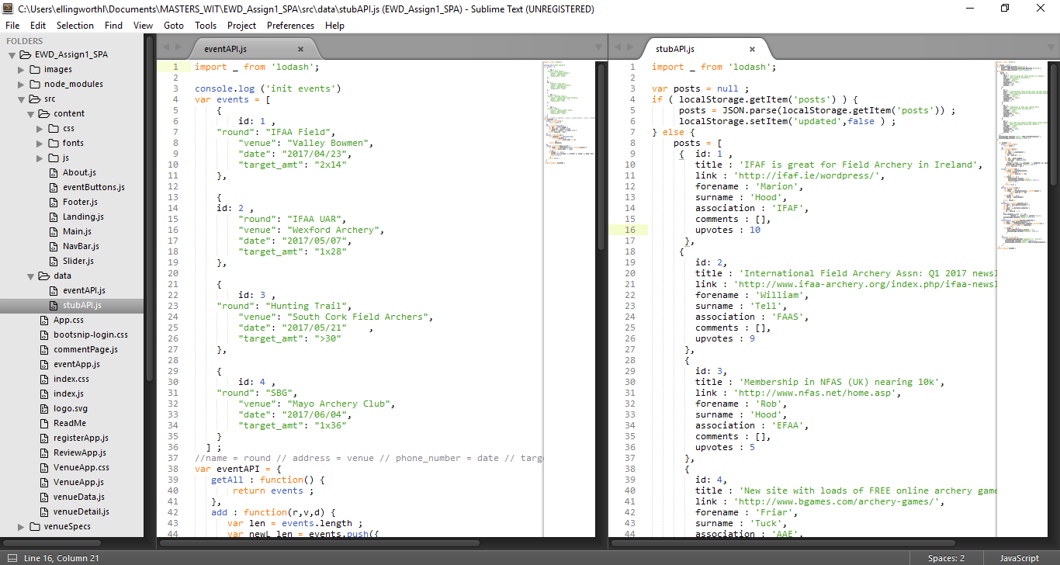
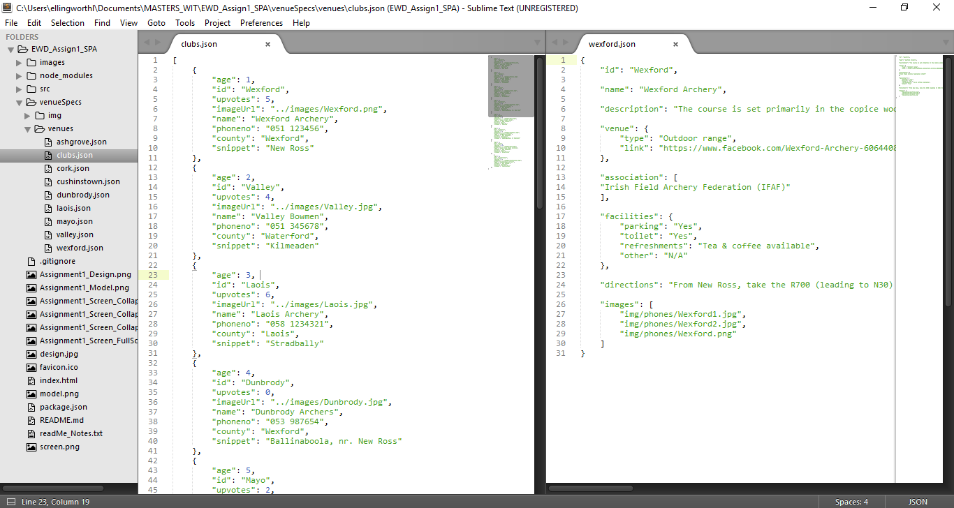
Assignment 1 - content
APIs used on the Events & Review Apps:
Events (eventAPI)
List all
Create new
Edit existing
Delete existing
Reviews (stubAPI)
List all reviews
Create new review
Upvote existing review
Comment on review
Upvote a comment
Both APIs write to local storage.
JSON files
clubs.json delivers data to VenueApp
Individual ‘venue’ json files provide detailed data to venueDetail

Slide 6
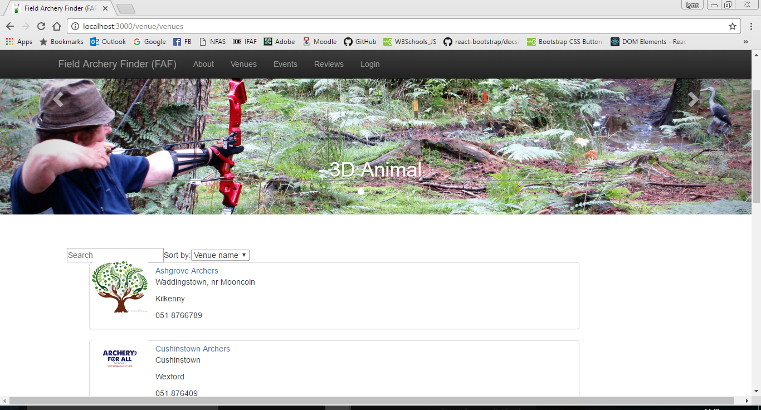
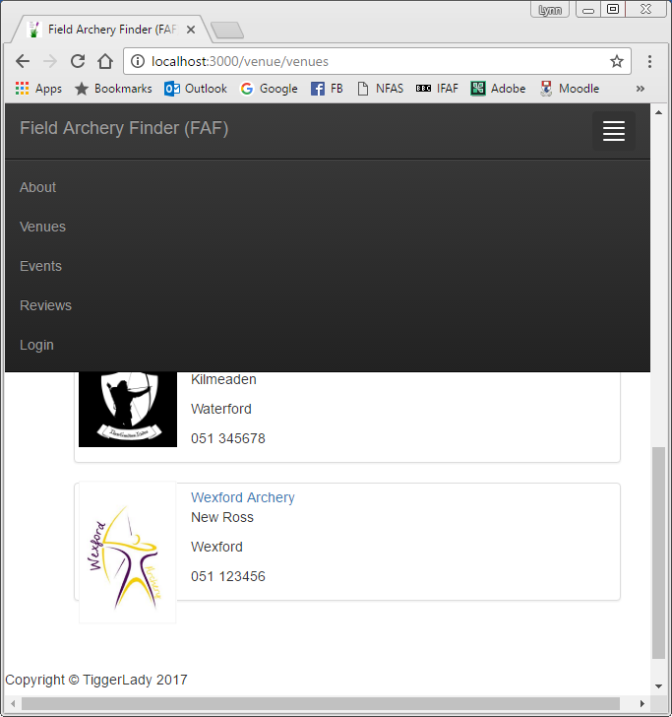
Assignment 1 - App design features
NavBar
Full-screen has navigation menu across the top of the page
Collapsed menu supports navigation across all devices, regardless of screen size
Slider
Code modified to ReactJS
Bootstrap CSS modified for FAF
Scrolling images illustrate the four elements of field archery
Footer
ReactJS component for footer
All ReactJS design elements persist throughout the App

Slide 7
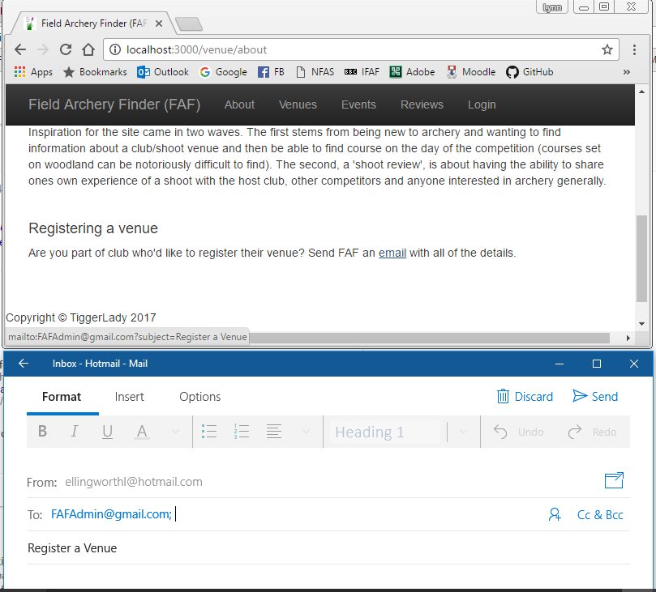
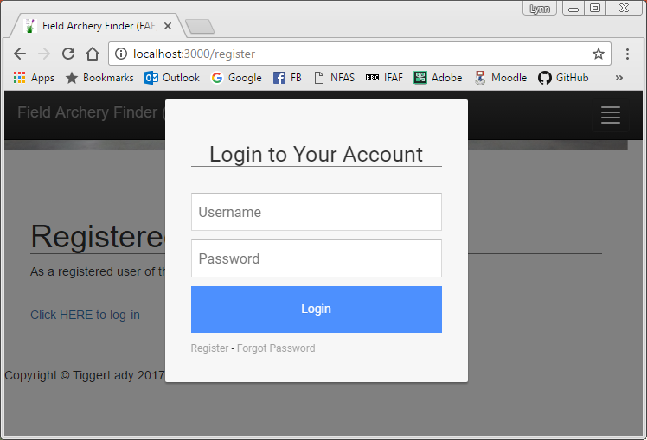

Assignment 1 - App design features cont.
About
Static page content, further information about FAF
Embedded ‘mailto’ feature to trigger email to FAF’s administrator
Register
Static, placeholder page for User authentication (to be built)
HTLM code converted to JS to work in the component
Bootsnipp login CSS applied
Favicon
A new Favicon designed for FAF
Booststap ‘half-slider’ CSS applied throughout the App.

Slide 8
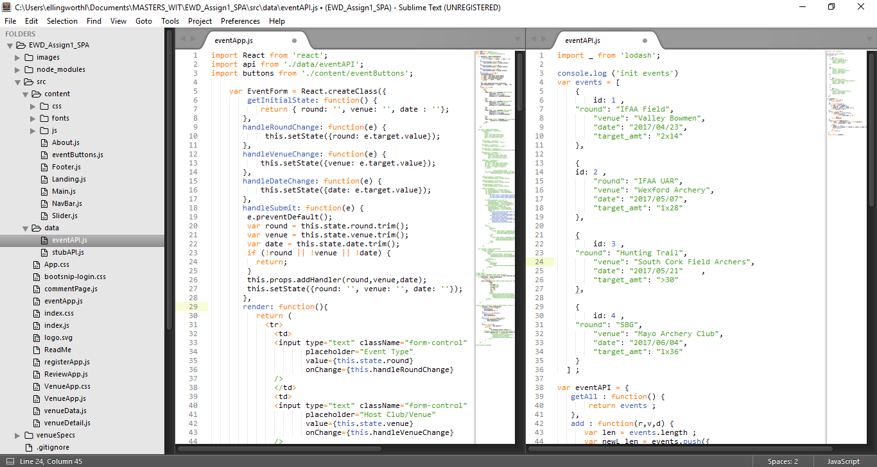
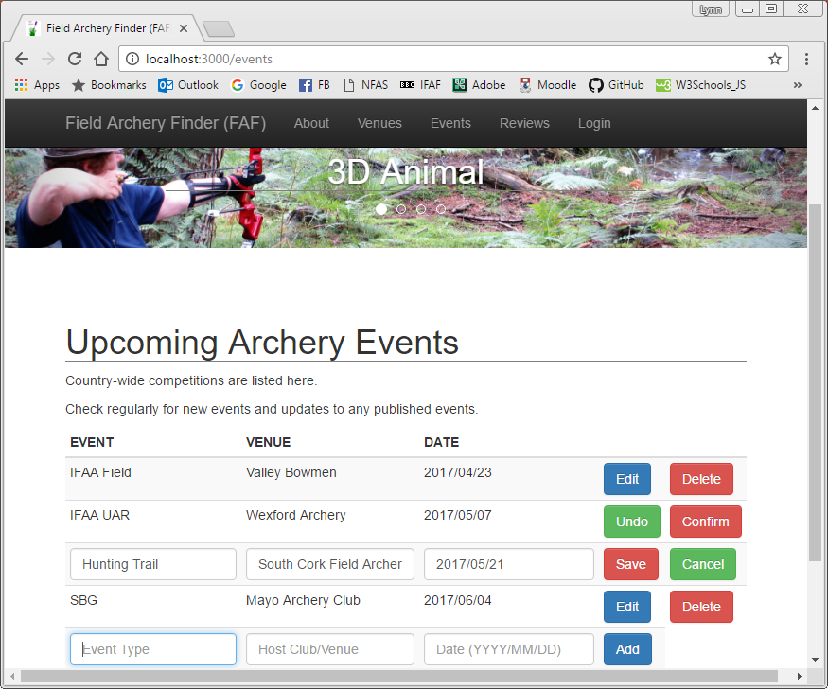
Assignment 1 - Expansion of Lab code #1
EVENTS (based on Contacts)
Functionality: CREATE, UPDATE & DELETE
eventApp
EventForm source code modified
Event source code modified
EventList source code modified
EventsTable source code modified (inc. different table styling)
eventAPI
events source code modified
eventsAPI source code modified

Slide 9
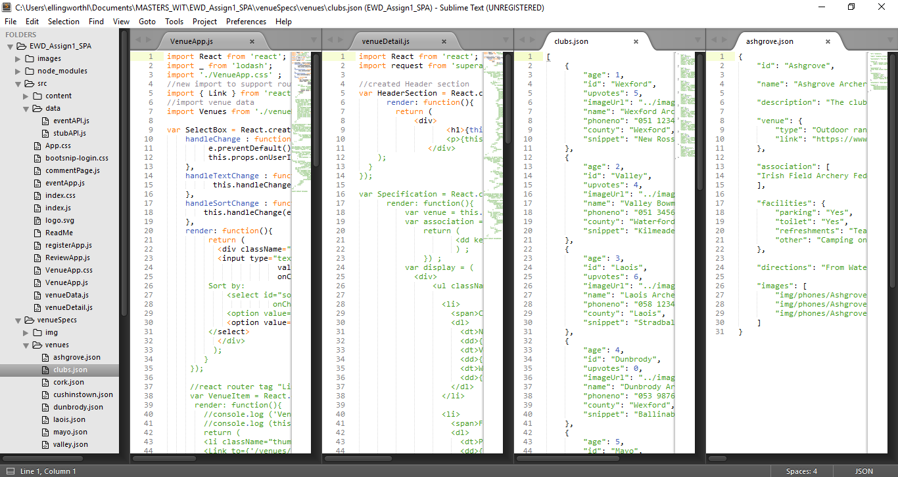
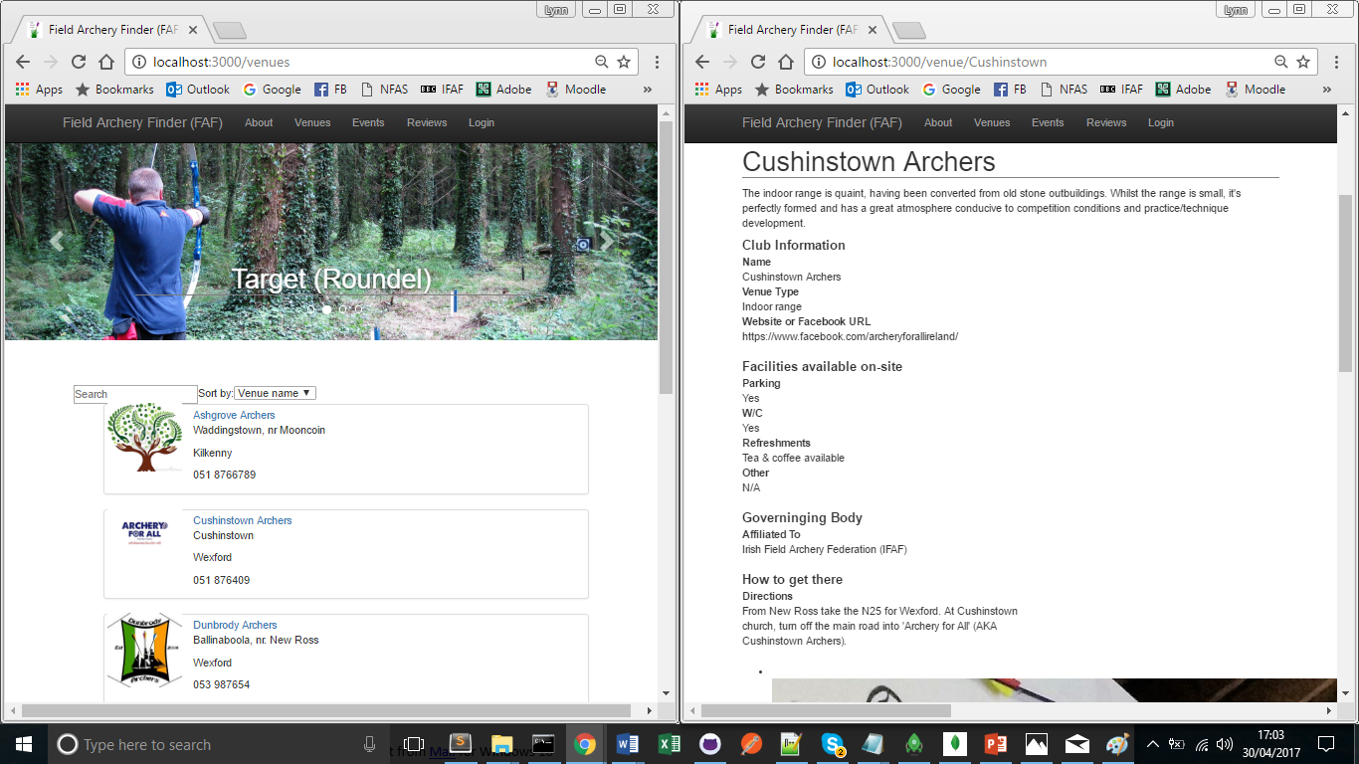
Assignment 1 - Expansion of Lab code #2
VENUES (based on Phone Catalogue)
Functionality: SEARCH (by name (text field)) & SORT (by Name or County (dropdown menu))
VenueApp
Update CCS to support formatting
Event source code modified
Add ‘Link’ import to support routing source code modified
Modify SelectBox to support name & county searches (dropdown) & name (text)
Modify VenueItem to include extra details (town & county) in addition to name and phone number
venueDetail
create HeaderSection
re-order Specification section
modify ImagesSection
re-order VenueDetail & add HeaderSection
clubs.json
expanded data-set for venueApp listing
Venues ( individual .json files)
complete reformat/use new data

Slide 10
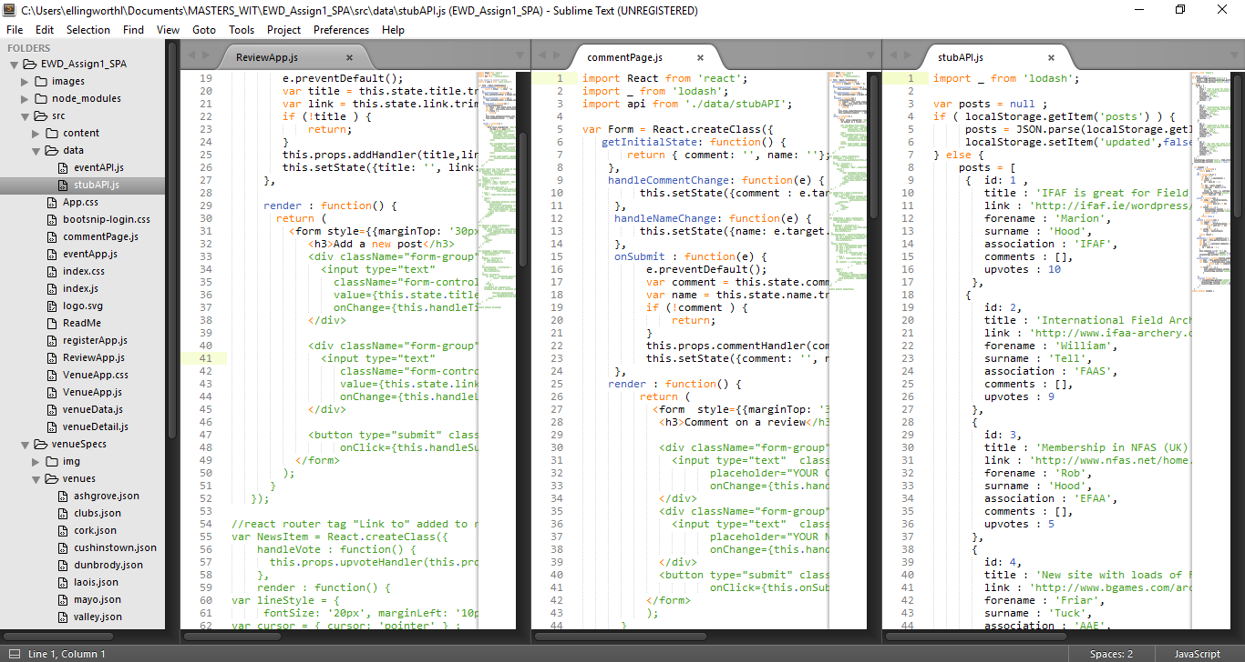
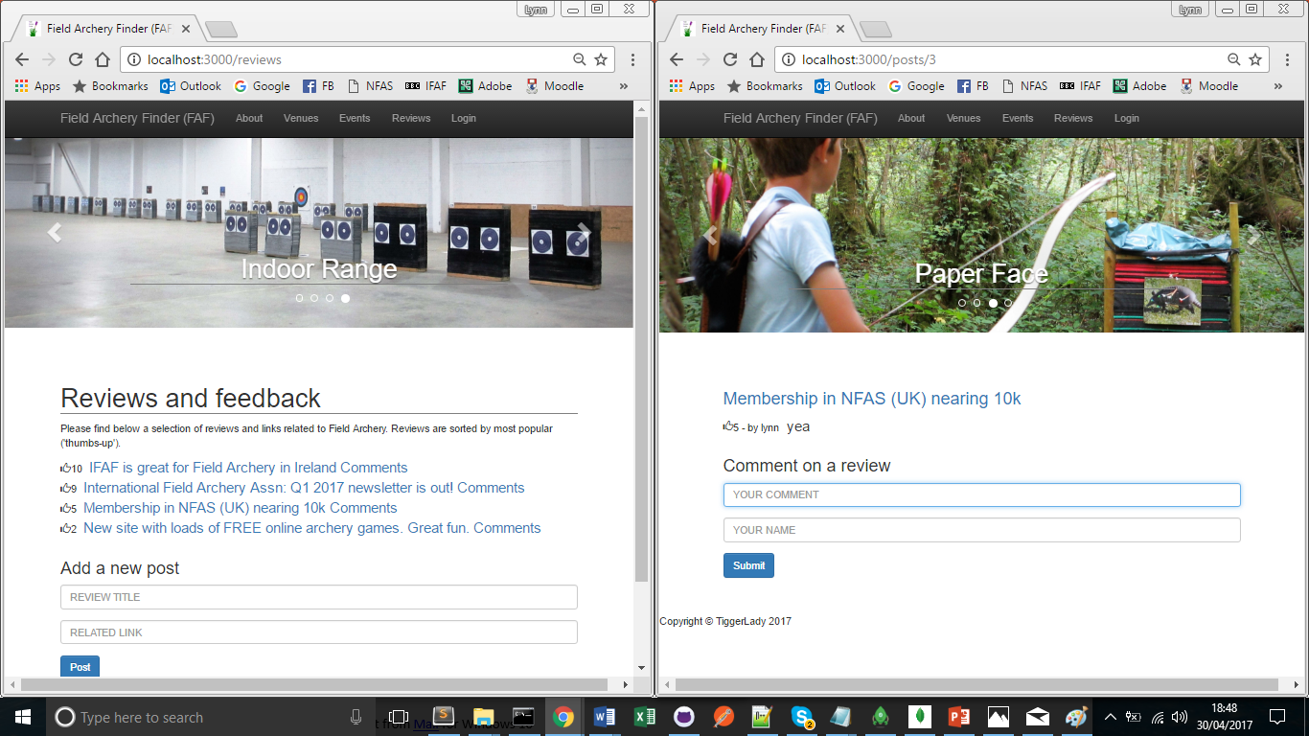
Assignment 1 - Expansion of Lab code #3
REVIEWS (based on Hacker News)
Functionality: CREATE & UPVOTE (create new review & upvote existing reviews and comment on reviews & upvote comments)
ReviewApp
Add ‘Link’ import to support routing source code modified
Form source code modified
ReviewApp source code modified inc. addition of Header & Paragraph to match other page formatting
commentPage
Form, source code modified
commentList limited changes to code
commentView limited changes to code
stubAPI
minimal changes

Slide 11
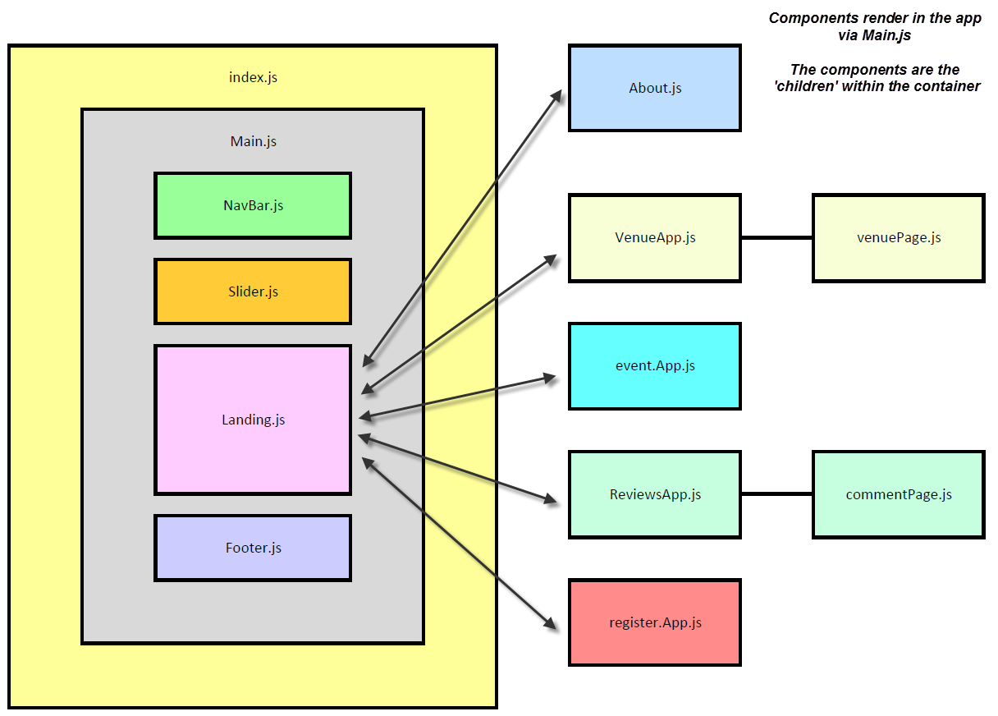
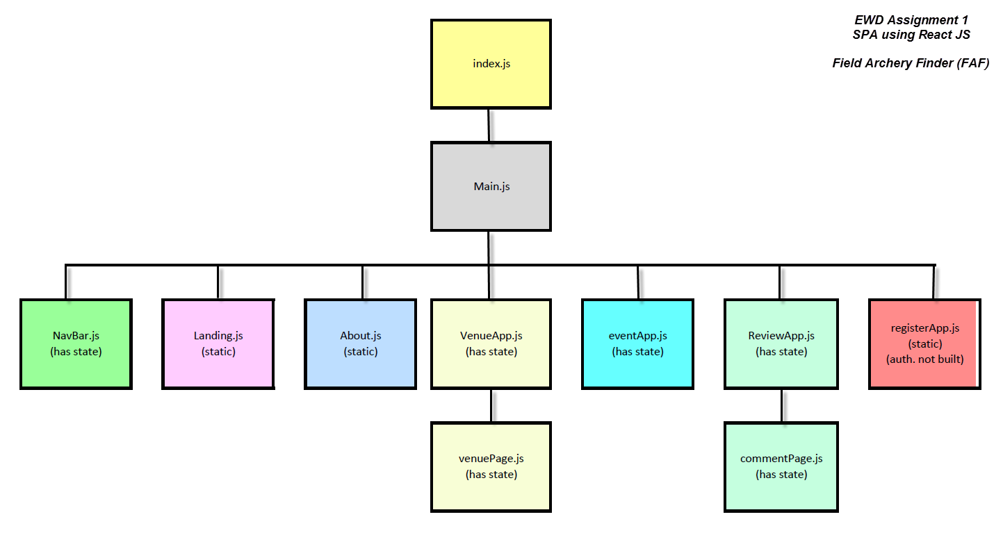
Assignment 1 - Design Model Illustrations

Slide 12
Assignment 1 - Independent Learning
Areas researched and applied in this assignment:
https://github.com/facebookincubator/create-react-app/blob/master/README.md#getting-started (a brilliant react tutorial)
https://www.kirupa.com/react/creating_single_page_app_react_using_react_router.htm (great, simple breakdown of principles of a SPA)
https://www.youtube.com/watch?v=MhkGQAoc7bc&list=PLoYCgNOIyGABj2GQSlDRjgvXtqfDxKm5b
https://github.com/learncodeacademy/react-js-tutorials
https://css-tricks.com/css-modules-part-3-react/
http://stackoverflow.com/questions/41515468/custom-stylesheet-in-react-app (install css loader: npm install --save css-loader )
http://pastebin.com/sLvADsEN
http://magic.reactjs.net/htmltojsx.htm
http://www.tutorialrepublic.com/twitter-bootstrap-tutorial/bootstrap-navbar.php
http://jsonlint.com/
http://www.favicon.cc/
https://startbootstrap.com/template-overviews/half-slider/
http://bootsnipp.com/snippets/featured/clean-modal-login-form
https://github.com/tylermcginnis/react-router-firebase-auth
Areas researched and applied in this assignment (cont):
Installed, but not used: https://www.npmjs.com/package/generator-react-webpack-scaffold
Registered for but not used (intended for Club Detail): https://developers.google.com/maps/documentation/android-api/signup
Additional learning for EWD has been through the following:
Head First: JavaScript
Head First: HTML and CSS
https://www.w3schools.com
https://www.youtube.com/playlist?annotation_id=annotation_270691829&feature=iv&list=PLoYCgNOIyGACDQLaThEEKBAlgs4OIUGif&src_vid=MhkGQAoc7bc
https://www.youtube.com/watch?annotation_id=annotation_3748334139&feature=iv&src_vid=9kJVYpOqcVU&v=pU9Q6oiQNd0
https://www.youtube.com/watch?v=Ybn6Q92m4xg
https://www.lifewire.com/list-of-command-prompt-commands-4092302

Slide 13

Assignment 2 - Web API for ReactJS SPA
Requirements for building, implementing & testing Web APIs:
Node: a tool built for the server side JavaScript code which is event-driven.
Express: a web application framework for Node.js which builds web apps (e.g. SPAs), back-end functions & APIs
MongoDB: a NoSQL database using a document-oriented data model
Mongoose: provides a simple validation and query API to help support interaction with databases on MongoDB

Slide 14
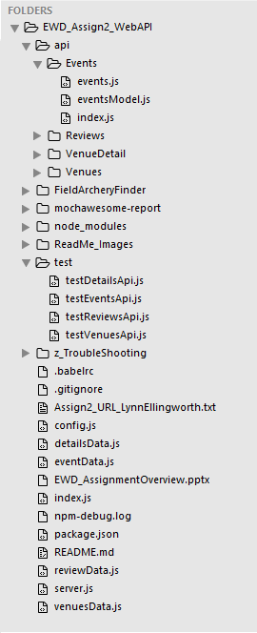
Assignment 2 - Project Structure
Overview of the project folder structure
Web API implementation
EWD_Assign2_WebAPI: Base folder for project (server-side)
api: Web API and Routing scripts
FieldArcheryFinder: web resources folder containing the ReactJS app
node_modules: files made available to scripts run through npm
Testing
mochawesome-report: folder containing the visual unit test reports
test: test APIs for unit testing CRUD

Slide 15
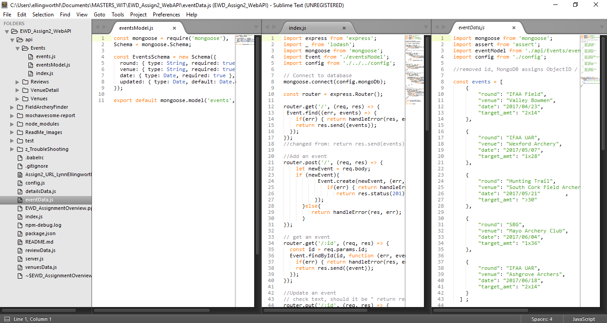
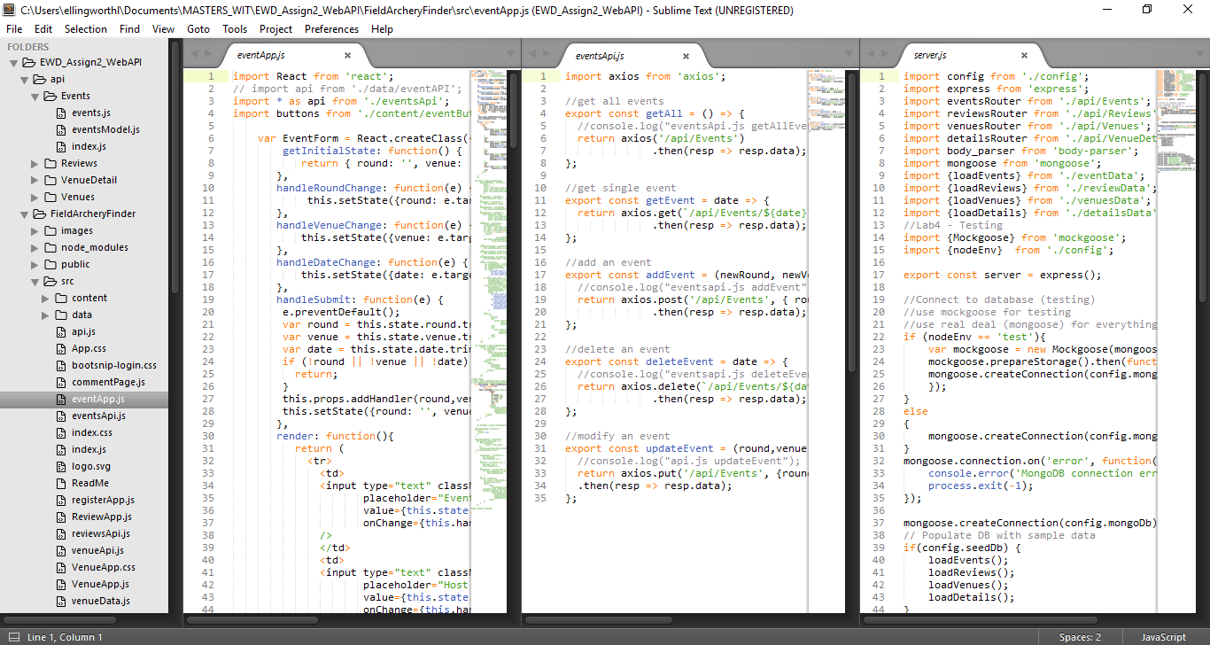
Assignment 2 - Coding for Web APIs
To support AIP creation and integration, and subsequent API validation using Mockgoose and Mocha, several files had to be created &/or updated.
Events shown as an example:
EWD_Assign2_WebAPI
eventData.js (new)
server.js (updated)
EWD_Assign2_WebAPI\api\Events
events.js (new)
eventsModel.js (new)
index.js (new)
EWD_Assign2_WebAPI\FieldArcheryFinder\src
eventApp.js (updated)
eventsApi.js (new)

Slide 16
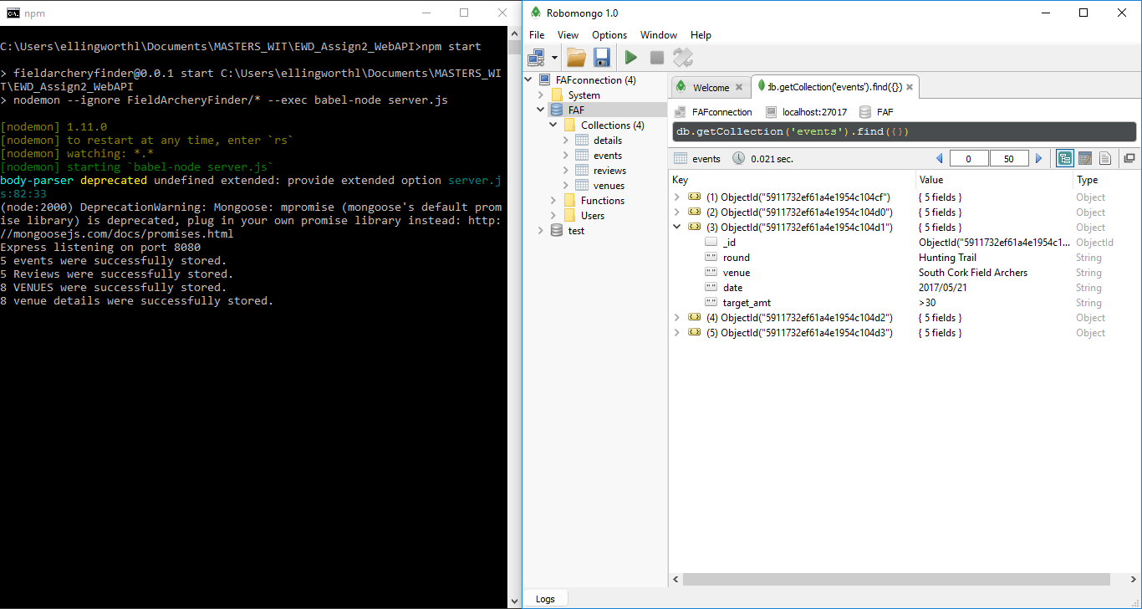
Assignment 2 - MongoDB & Robomongo
Express is launched in the base folder. Upon completion, the console displays:
Express listening on port 8080
5 events were successfully stored.
8 VENUES were successfully stored.
5 Reviews were successfully stored.
8 venue details were successfully stored.
The data in the data files listed is seeded to the FAF database in MongoDB
detailsData.js
eventsData.js
reviewsData.js
venuesData.js
Collections are created for each API, and the data is written as an object within its collection

Slide 17
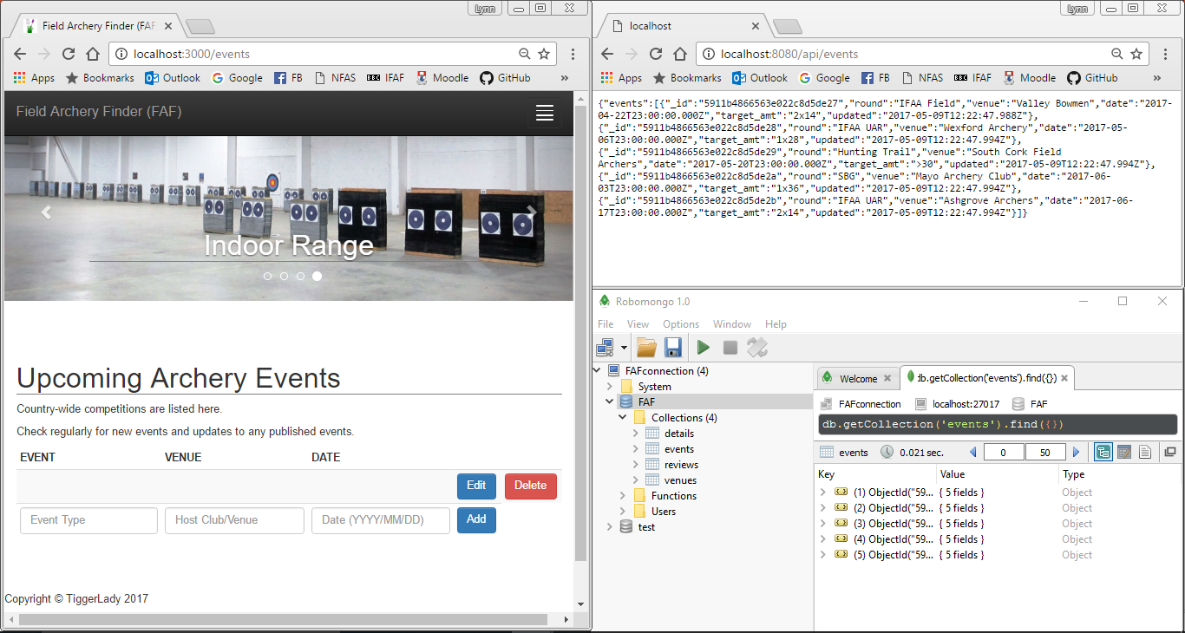
Assignment 2 - SPA & Web API data
The client app (FAF) operates on Port 3000
The React components with API’s should render data from MongoDB. However, as seen with the EventsApp the objects in the events collection are not returned.
Example:
http://localhost:3000/events
The server operates on Port 8080
The objects in the events collection can be seen in the browser, via localhost:8080 API .
Example:
http://localhost:8080/api/events

Slide 18
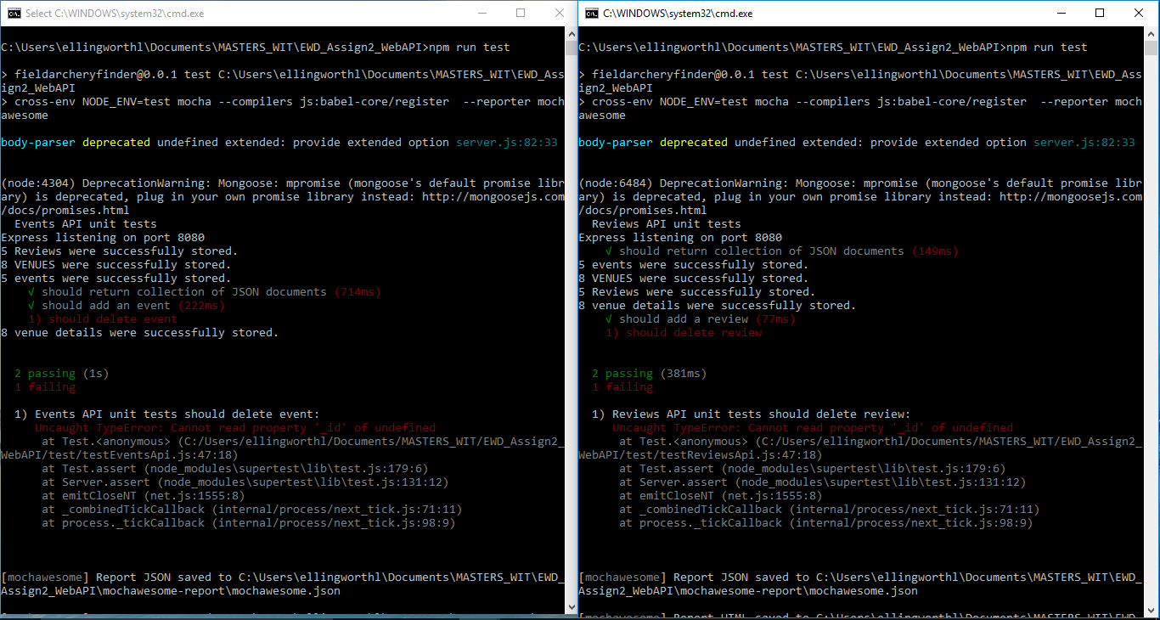
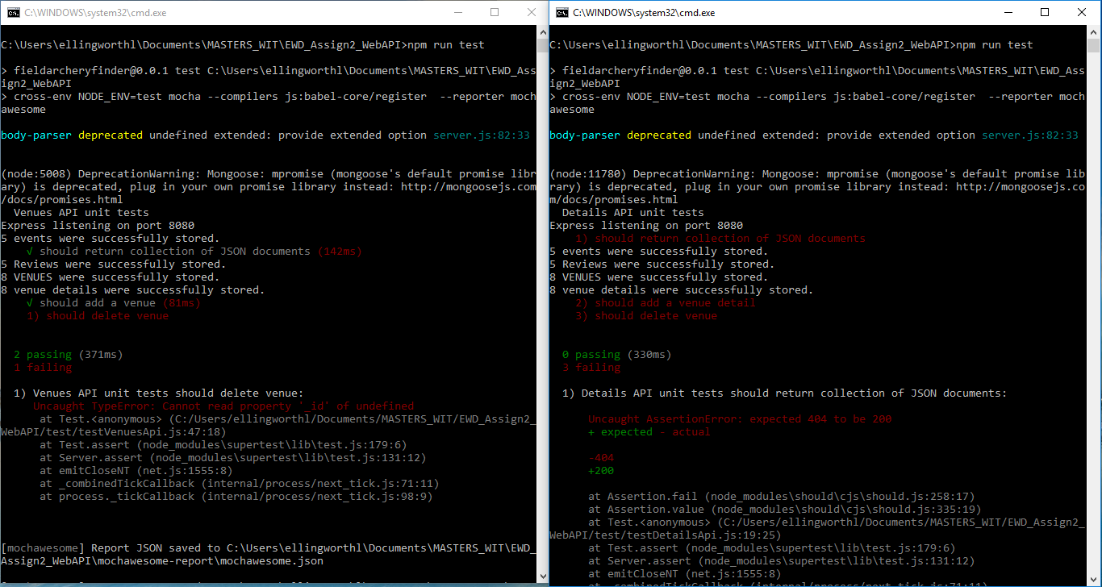
Assignment 2 - Mocha API testing
Open a CMD window in the root folder. Use command “npm run test” to run unit tests against each test API
testEventsApi.js
return collection .JSON files = Pass
add an event = Pass
delete an event = Fail
testEventsApi.js
return collection .JSON files = Pass
add an event = Pass
delete an event = Fail
testVenuesApi.js
return collection .JSON files = Pass
add an event = Pass
delete an event = Fail
testDetailsApi.js
return collection .JSON files = Fail
add an event = Fail
delete an event = Fail

Slide 19
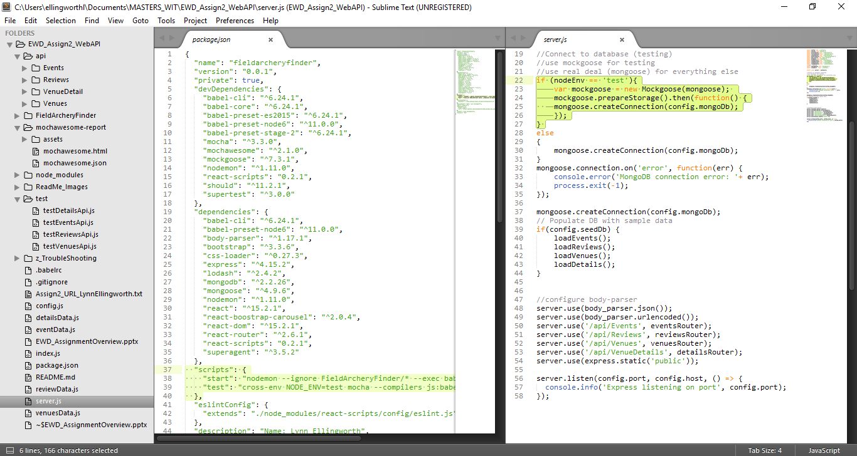
Assignment 2 - Mockgoose API testing
To support Mockgoose, 3 things must be done
In CMD window in root folder, run “npm install save-dev cross-env”
server.js need to have node env “test” specified, in which instace Mochgoose, rather than Mongoose, is used to store data locally
Package.json needs to have “test” specified in the scripts

Slide 20
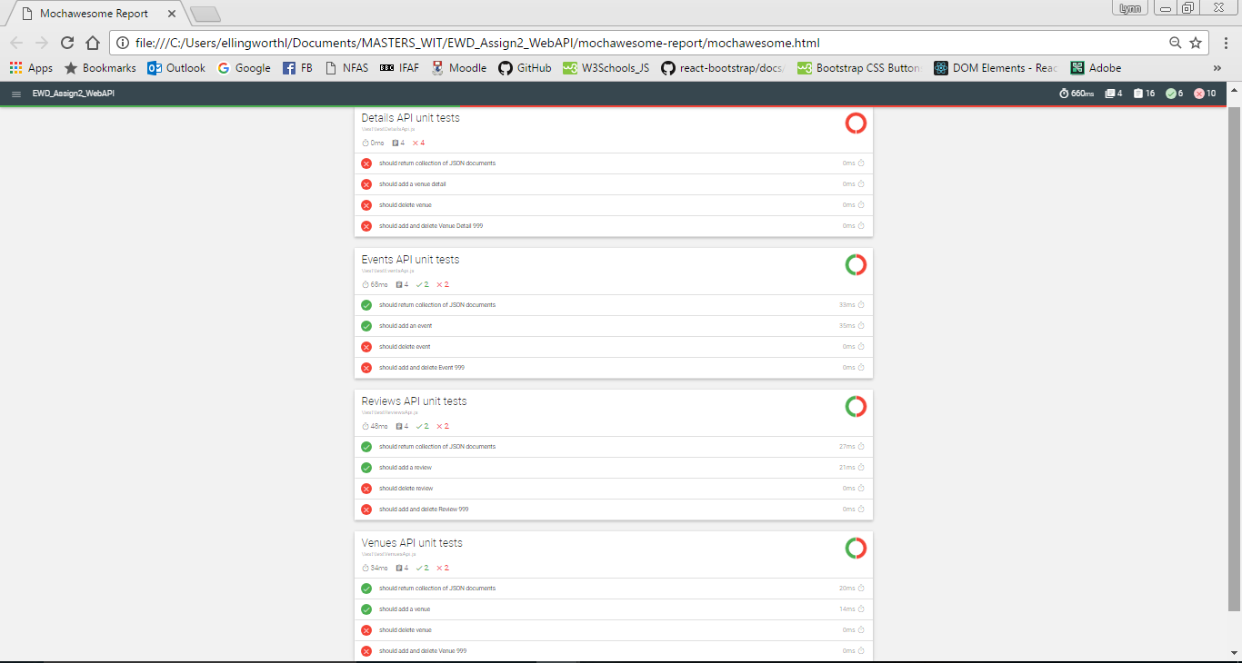
Assignment 2 - Mochawsome reporting
The test results from Mocha API unit testing are visually reppresented in Mochawsome’s GUI

Slide 21
Assignment 2 - Independent Learning
Areas researched and applied in this assignment:
https://robomongo.org/
https://www.getpostman.com
https://cloud.mongodb.com/user#/login?nds=true
https://docs.mongodb.com/manual/reference/mongo-shell/
https://www.mongodb.com/
https://www.npmjs.com/package/mongodb
https://mongodb.github.io/node-mongodb-native/
Additional learning for EWD has been through the following:
https://docs.mongodb.com/manual/reference/mongo-shell/
https://www.digitalocean.com/community/tutorials/how-to-connect-node-js-to-a-mongodb-database-on-a-vps
https://www.youtube.com/watch?v=pWbMrx5rVBE
https://www.youtube.com/watch?v=nN2JlbVWy2k&t=40s
https://www.youtube.com/watch?annotation_id=annotation_1262334303&feature=iv&src_vid=5e1NEdfs4is&v=ndKRjmA6WNA
https://www.youtube.com/watch?v=U8XF6AFGqlc
https://www.youtube.com/watch?v=gnsO8-xJ8rs
http://stackoverflow.com/ (multiple queries about MongoDB and Mongoose.)
http://mongoosejs.com/
http://www.tutorialspoint.com/mongodb/
https://ddrohan.github.io/wit-wad/topic02-node/talk-3-node-3/node.3.pdf

